Slide 1

SEMINAR ON
Biometric Based Authentication
Presented By : Sasanka Shekhar Das
Regd. No. : 2201287522
Instructed by : Prof.Sahasranshu Das
GITA Autonomous College,
Bhubaneswar

Slide 2
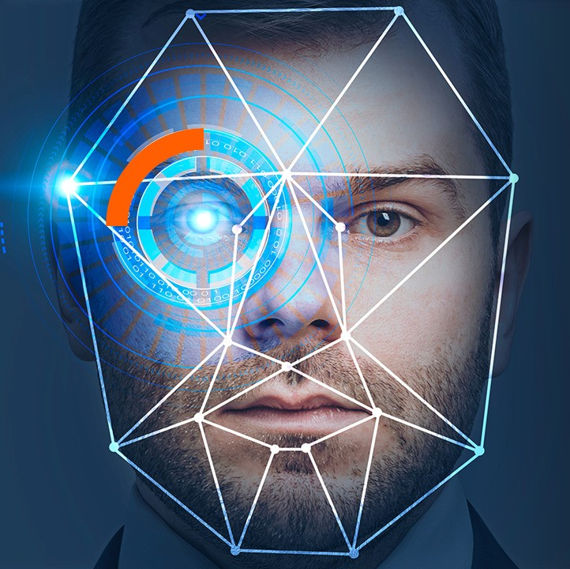
Biometric Authentication:
This presentation introduces biometric authentication and its growing importance. Biometric authentication uses unique biological or behavioral traits to verify a person's identity, offering a secure and convenient alternative to traditional methods like passwords.

Slide 3
What is Biometric Authentication?
Defining Biometrics
Biometric authentication is the process of verifying a person's identity using unique biological or behavioral characteristics, also known as biometrics.
Types of Biometric Authentication:
Fingerprints
Facial recognition
Iris scans
Voice recognition

Slide 4
Physiological Biometrics
Fingerprint Scanning
It uses ridge patterns and various sensor technologies like Optical, capacitive, and ultrasonic sensors which are common.
Facial Recognition
It use Algorithms analyze facial features. NIST study shows a 0.2% error rate in ideal settings.
Iris Scanning
It Captures unique iris patterns with high accuracy. It Resistant to spoofing and offering robust security.

Slide 5
Behavioral Biometrics
Voice Recognition
Analyzes speech patterns, influenced by environment and health. It’s Accuracy can exceed 90% in controlled settings.
Signature Dynamics
It Analyzes signing speed, pressure, and rhythm. Used in fraud detection, but has around 15% error rate.

Slide 6
Advantages of Biometric Authentication
Enhanced Security
Biometric data is difficult to forge or steal, boosting security.
Convenience
Eliminates the need to remember passwords or carry tokens.
Accountability
Provides strong audit trails and non-repudiation for compliance.

Slide 7
Challenges of Biometric Authentication
Collecting and storing sensitive data can lead to privacy issues.
Environmental factors can affect the accuracy of data.
Spoofing attacks take advantage of security weaknesses.
Implementing security measures can be costly.

Slide 8
Applications: Security and Access Control
Border Security
Facial recognition at airports and border crossings enhances the security.
Building Access
Fingerprint or iris scanners secure entry to buildings.
Law Enforcement
Identifying suspects using biometric databases to improves crime solving.

Slide 9
Consumer Electronics and Finance
1. Smartphones
Fingerprint and facial recognition unlock devices and authenticate payments.
2. Banking
Voice recognition secures phone banking. Biometric ATMs enhance security.
3. Healthcare
Patient identification using biometrics improves accuracy and security.

Slide 10
Future Trends in Biometric Authentication
Multimodal Biometrics
Combining multiple traits which increases accuracy and security.
Contactless Biometrics
Facial and iris scanning gain popularity due to hygiene.
AI-Powered Biometrics
Machine learning improves accuracy and fraud detection.
Biometric Payment Systems
Integration with digital wallets streamlines transactions.

Slide 11
Conclusion: The Future is Biometric
Biometric authentication improves both security and convenience. It is important to address privacy and security concerns for widespread adoption. Innovation will lead to new applications in this field.
Embrace innovation
Prioritize security
Respect privacy

Slide 12
Thank You

